Slide 1

Enhancing Retrieval for Fact-Based Question Answering on Cancer Literature Using RAG & Pandas AI Techniques
NETI THEERTHA BHASKARA SRI SAI
Student ID: 1130075
Final Thesis Presentation for Master of Science in Data Science Liverpool John Moores University
FEBRUARY 2025

Slide 2
INTRODUCTION
BACKGROUND
The field of cancer research is rapidly expanding, generating a vast amount of literature.
Efficiently understanding this literature is crucial for researchers, clinicians, and patients.
Generative AI is a vast development field which reduces manual efforts in all fields.
CHALLENGES WITH EXISTING APPROACHES
Traditional NLP techniques often struggle to handle the complexity of medical language.
This complexity arises from the use of specialized terminology and the diverse nature of data sources.
Retrieving information from both structured and unstructured sources is having challenges to a particular domain.

Slide 3
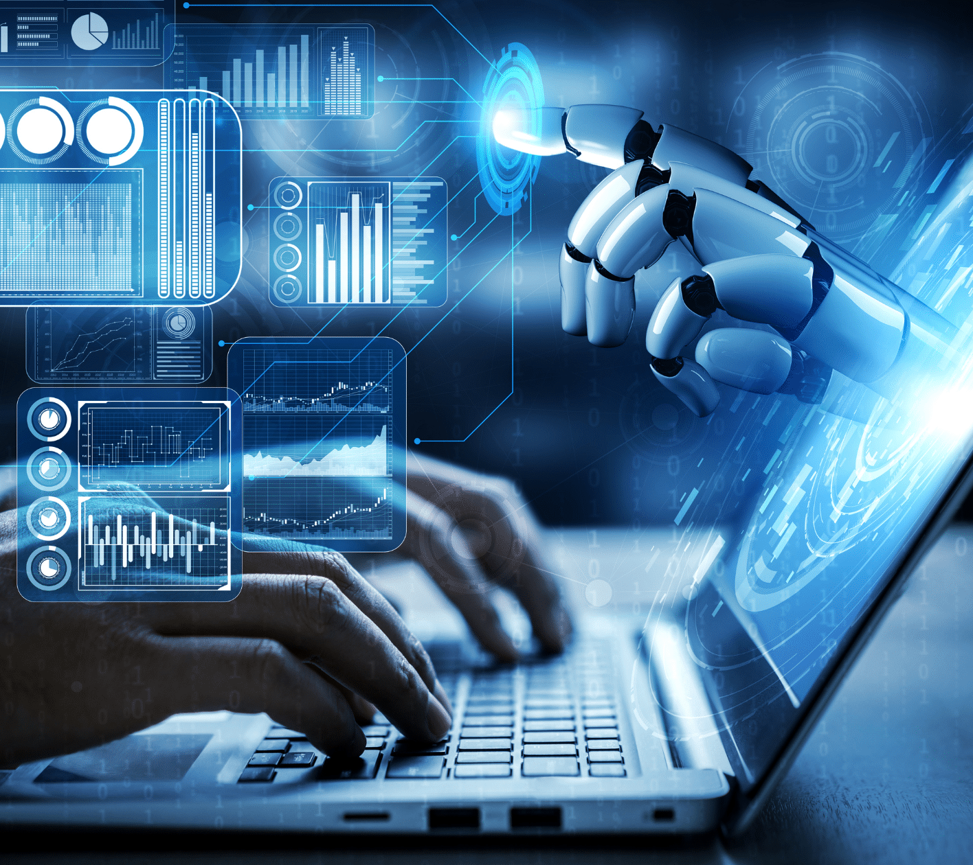
INTRODUCTION
RESEARCH MOTIVATION
This research is crucial to improve cancer care by giving researchers and clinicians apt information.
It enhances decision support by integrating LLMs with cancer data analytics, offering healthcare professionals timely and data-driven insights.
Provides scalable and adaptable tools, this work supports the advancement of oncology care contributing to the broader goal of global health equity.

Slide 4

AIM AND OBJECTIVES
DATA PREPROCESSING
Extracting the content from cancer documents for both structured and unstructured data.
Using the Python libraries, convert text data to vector embeddings and store it in the database.
LEVERAGE LLM TECHNIQUES
Using Retrieval Augmented Generation, Pandas AI and advanced Python libraries.
Similarity search will be implemented for the query asked by the user.
UTILIZING LLM FOR QUESTION ANSWERING
Using Gemini Pro & GPT-4 for the response Generation.
Checking performance, and accuracy of the LLM for contextual-based text responses.

Slide 5

LITERATURE REVIEW
This research identifies several Challenges and Gaps such as:
Validation of AI-generated content
Ethical considerations in healthcare
Bias and accuracy in generated content
Standardization of datasets
Privacy and Security considerations

Slide 6

LITERATURE REVIEW
GENERATIVE AI APPLICATIONS:
This review mentions the importance of Generative AI applications in various fields such as education, healthcare, marketing, and the IT industry.
It emphasizes the potential of Generative AI to revolutionize question-answering systems, particularly in the context of medical and healthcare domains.
TECHNIQUES AND CAPABILITIES:
Discussed techniques like RAG, and Pandas AI with Large Language Models by exploring their capabilities, usage, and limitations.
This review delves into the strengths and weaknesses of LLMs in handling complex questions and working with diverse datasets.

Slide 7

LITERATURE REVIEW
PANDA: FACILITATING USABLE AI DEVELOPMENT
This paper explains about data collection, preparing data, visualize and interact, designing models, and building solutions and interacting with AI.
A FAISS-BASED SEARCH FOR STORY GENERATION
Generating stories based on input keywords using a FAISS-based search approach. It encodes pre-processed data with a sentence transformer.
TOWARDS A RAG-BASED SUMMARIZATION AGENT
It assists in managing & retrieving vast amounts of documentation and data efficiently. RAG agents will look into big databases to find the right information.

Slide 8
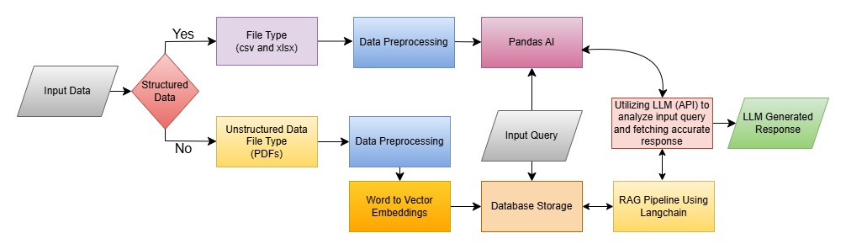
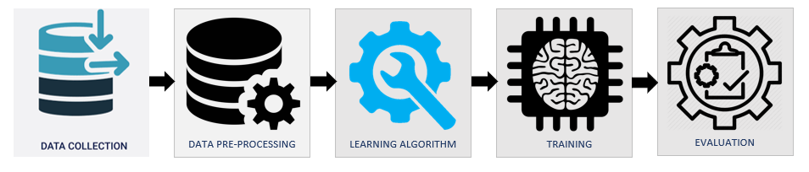
METHODOLOGY

Slide 9

METHODOLOGY
DATA ACQUISITION:
This research utilized datasets from the ICCR & CBIO portals.
The datasets include both structured and unstructured data
DATA PREPROCESSING:
Data Cleaning
Normalization
Data Visualization

Slide 10


METHODOLOGY
MODEL DEVELOPMENT:
Structured Model: Utilized Pandas AI for data analysis, data frame storage, prompt tuning & GPT-4
MODEL EVALUATION:
Evaluate the performance of both models using qualitative evaluation by comparing their responses to those generated by other LLMs like ChatGPT and manual evaluation.
Unstructured Model: Used Langchain and FAISS for information retrieval, Google Generative AI Embeddings for text-to-vector conversion, prompt tuning and Gemini Pro, RAG technique.

Slide 11
IMPLEMENTATION
STRUCTURED MODEL EXPERIMENTATION:
Requirements:
Pandas AI library, Azure Smart Data Lake and Azure Open AI.
Streamlit for UI, Python 3.10.14, GPT-4.
File Processing:
Upload documents and Supported files types are CSV and Excel.
Extract the data into data frames and store.
The data lake is configured with data frames, prompt tuning, sending input prompt
Response Generation:
The Pandas AI algorithm converts natural language questions into SQL queries to fetch accurate responses from the smart data lake DB.
Using GPT-4 the obtained response will be finetuned.

Slide 12
IMPLEMENTATION
UNSTRUCTURED MODEL EXPERIMENTATION
Requirements:
PYPDF2, LangChain
NLTK for lemmatization & stop word
Streamlit for UI
Python 3.10.14
Text Preprocessing:
Textual data is divided into chunks of 5000 characters with a 1000 characters overlap.
Embedding and Storage:
Text chunks are converted into vector embeddings using LangChain's Google Generative AI Embeddings(001).
These embeddings are stored locally in a FAISS database with '.faiss' and '.pkl' extensions

Slide 13
IMPLEMENTATION
UNSTRUCTURED MODEL EXPERIMENTATION
Conversational Chain and Model Use:
The conversational chain is prepared with a customized system prompt.
Gemini-pro model is used with a temperature setting of 0.3.
The prompt configuration is applied to load the QA chain for generating responses.
Question Answer Generation:
User queries are processed, converted to embeddings, and passed to FAISS DB
Langchain retrieval brings the top 3 matching chunks.
Gemini Pro enhances the response.

Slide 14
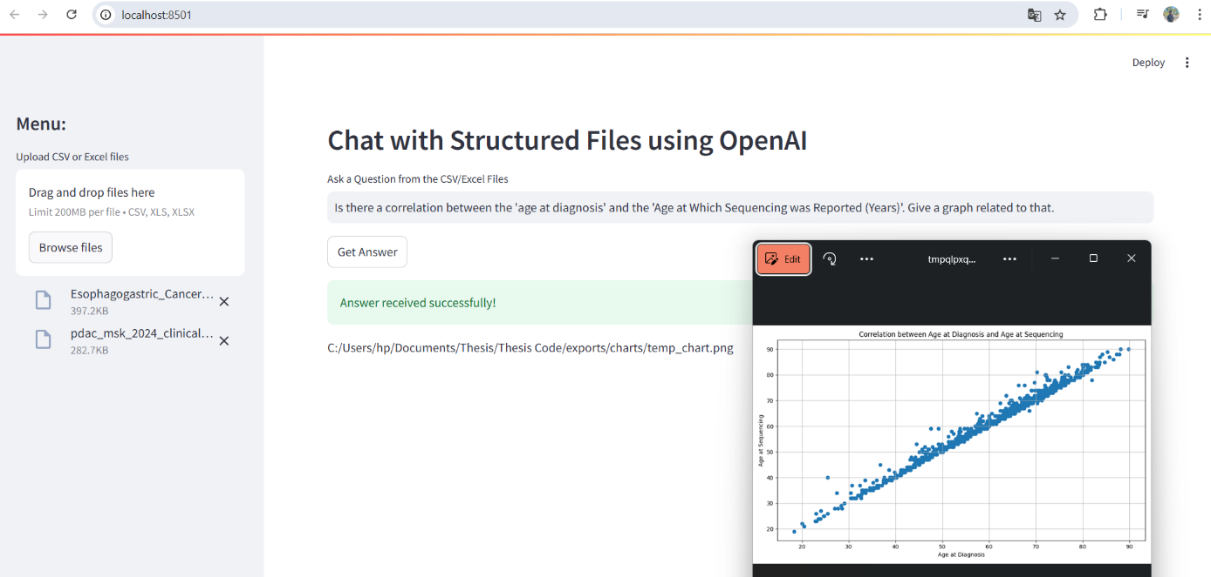
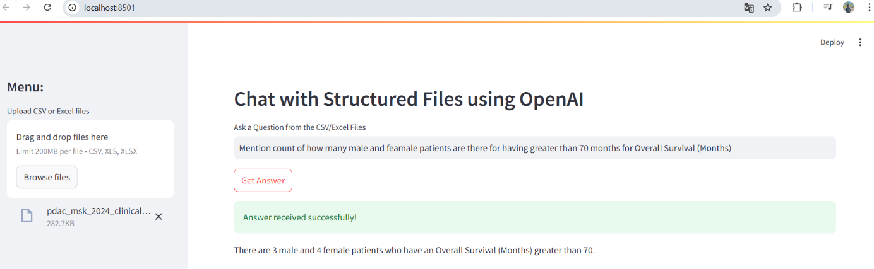
RESULTS AND DISCUSSION
STRUCTURED APPROACH:

Slide 15
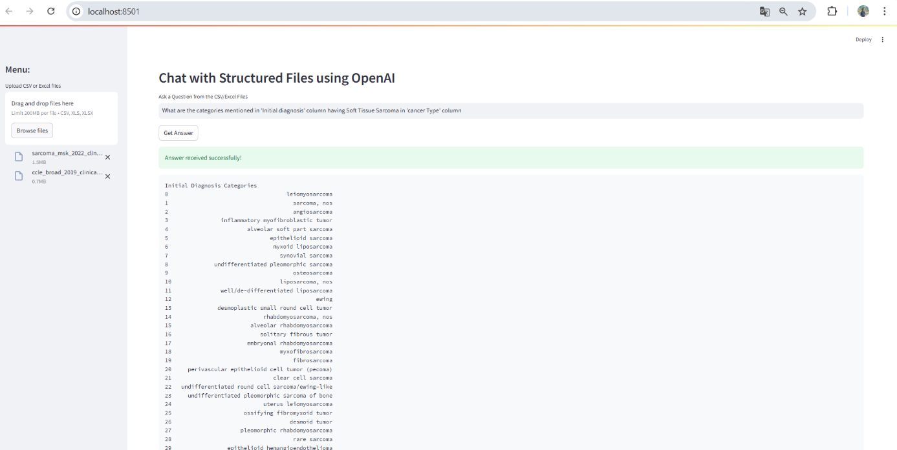
RESULTS AND DISCUSSION
STRUCTURED APPROACH:

Slide 16
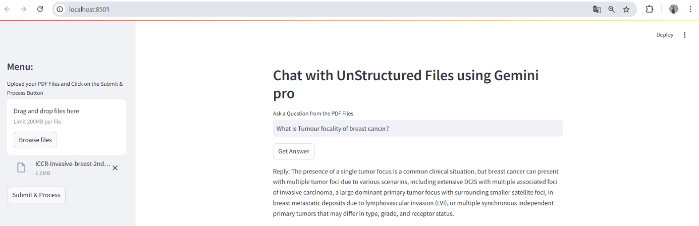
RESULTS AND DISCUSSION
UNSTRUCTURED APPROACH:

Slide 17
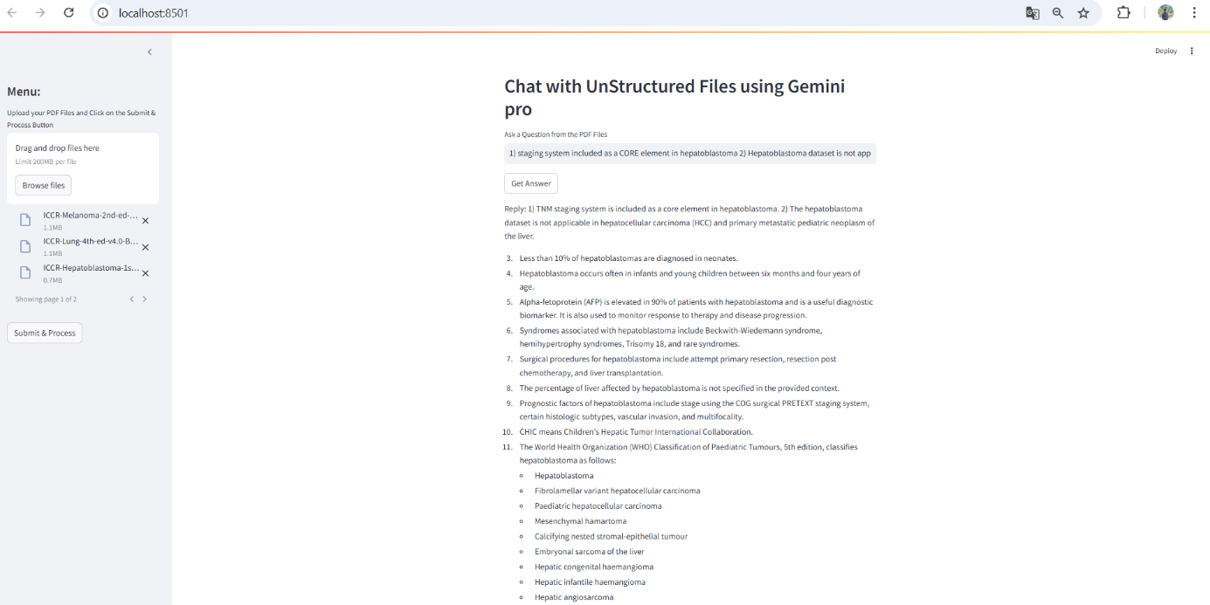
RESULTS AND DISCUSSION
UNSTRUCTURED APPROACH:

Slide 18
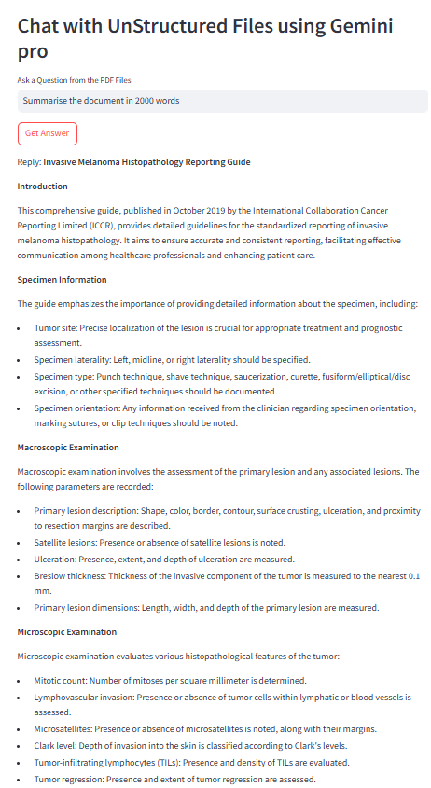
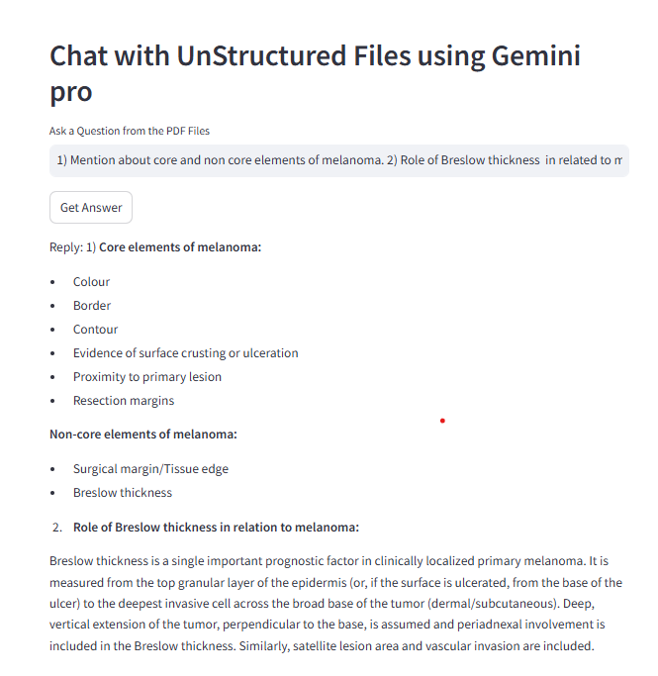
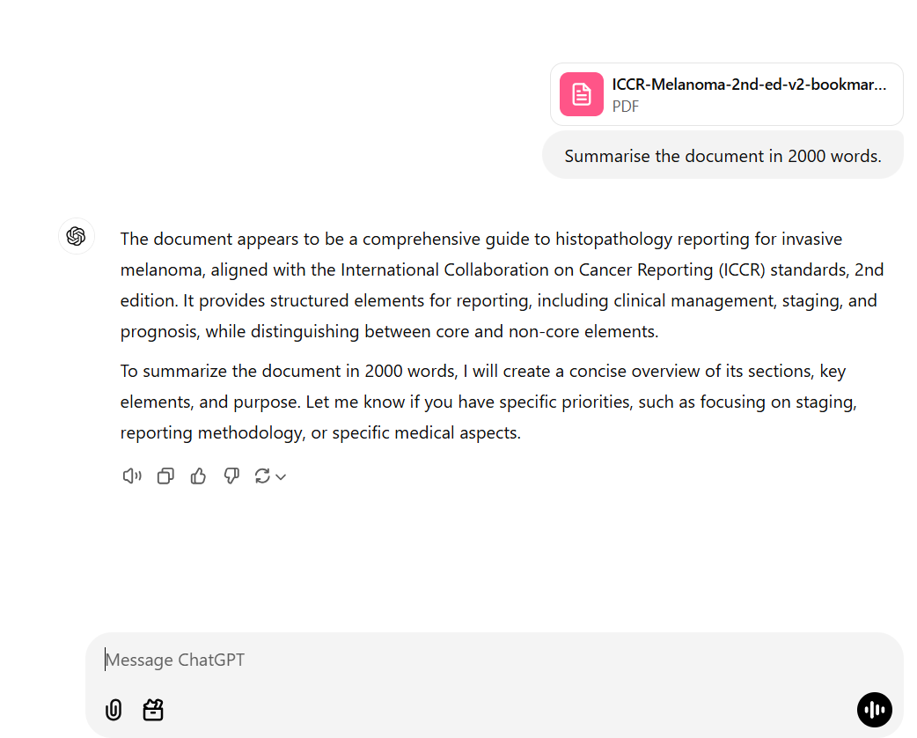
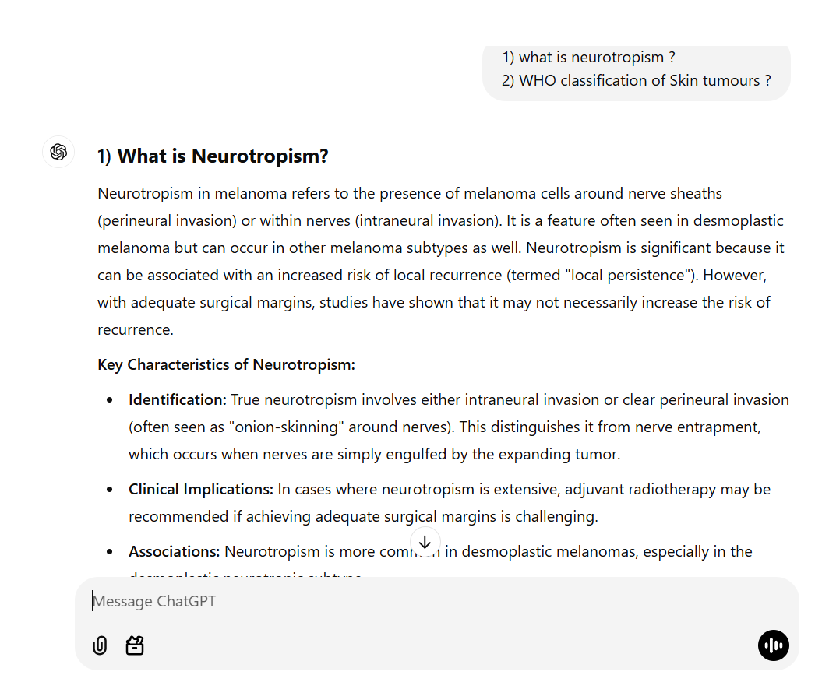
RESULTS AND DISCUSSION
Qualitative Evaluation for Unstructured Approach:

Slide 19
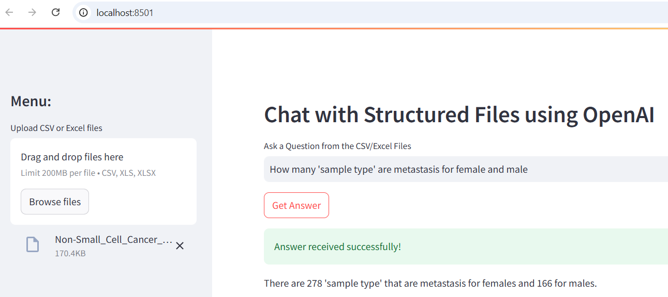
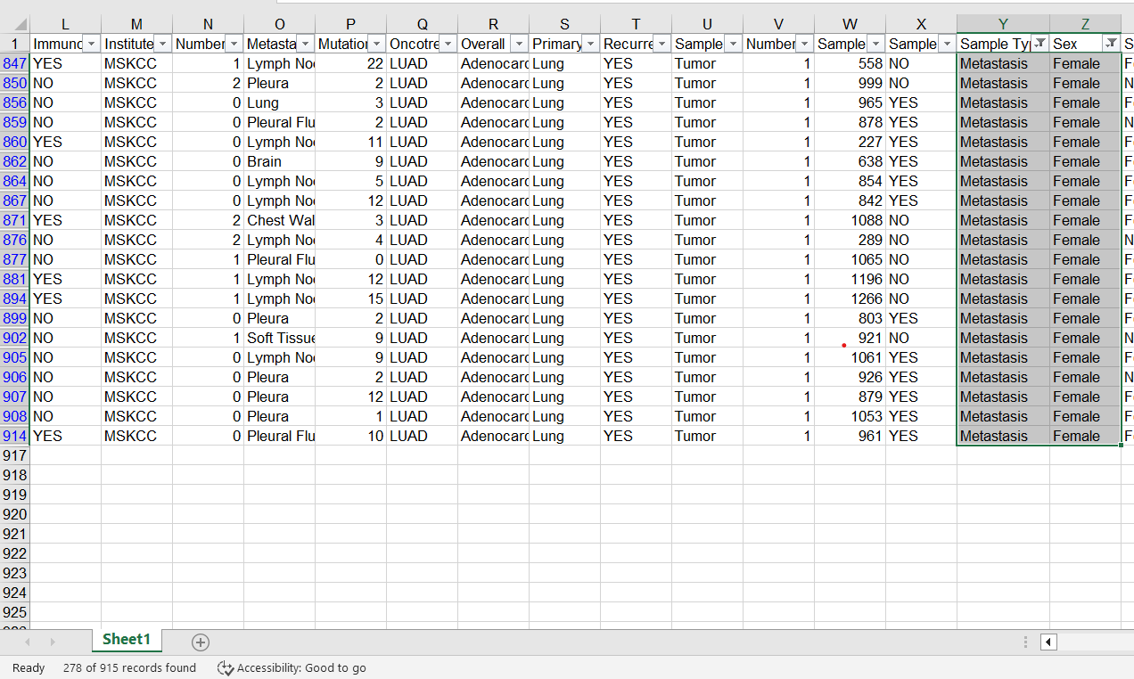
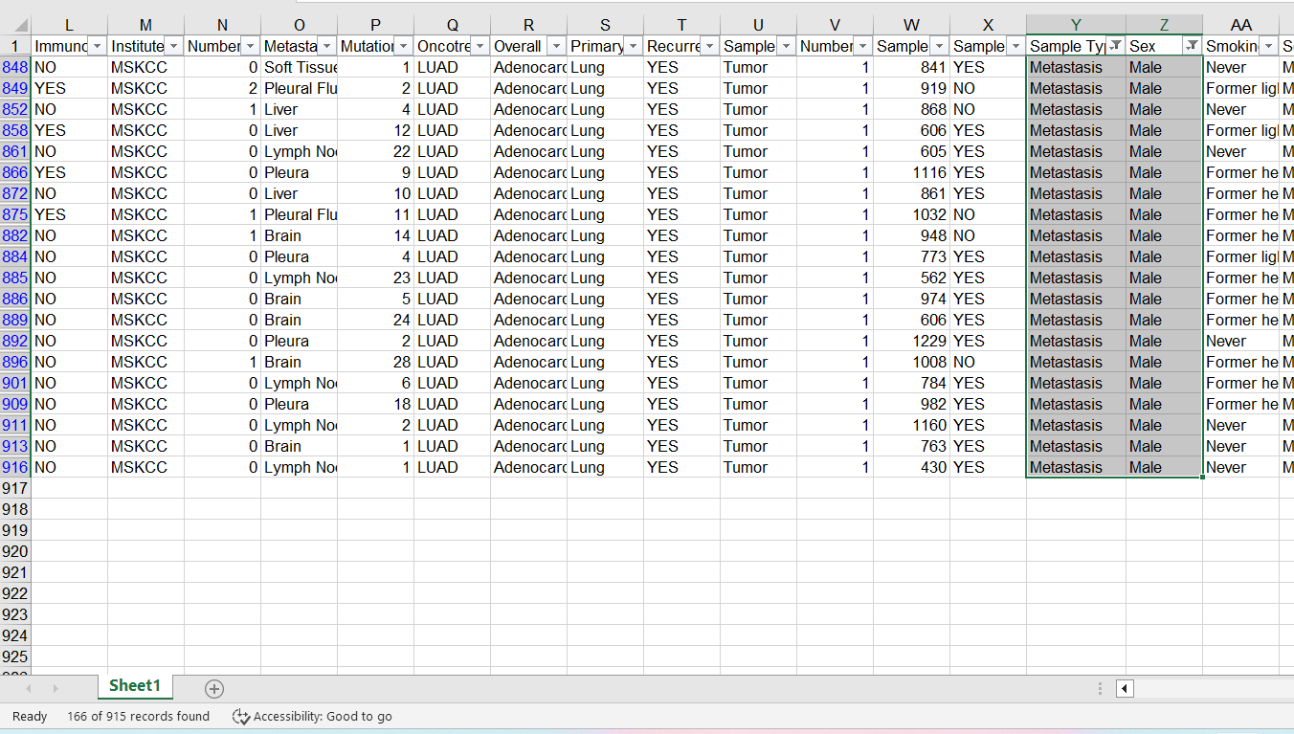
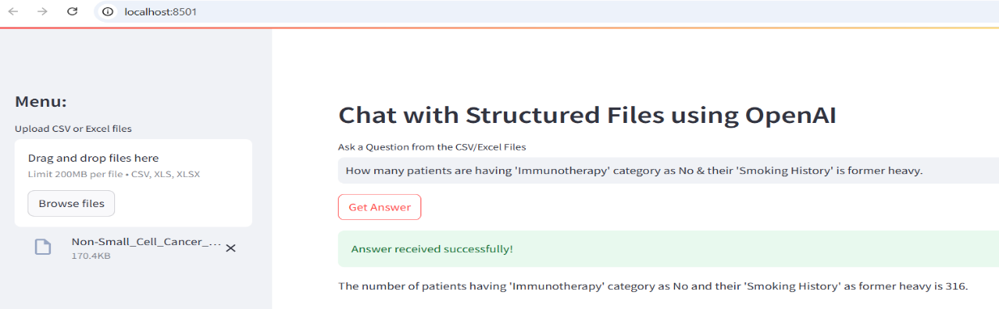
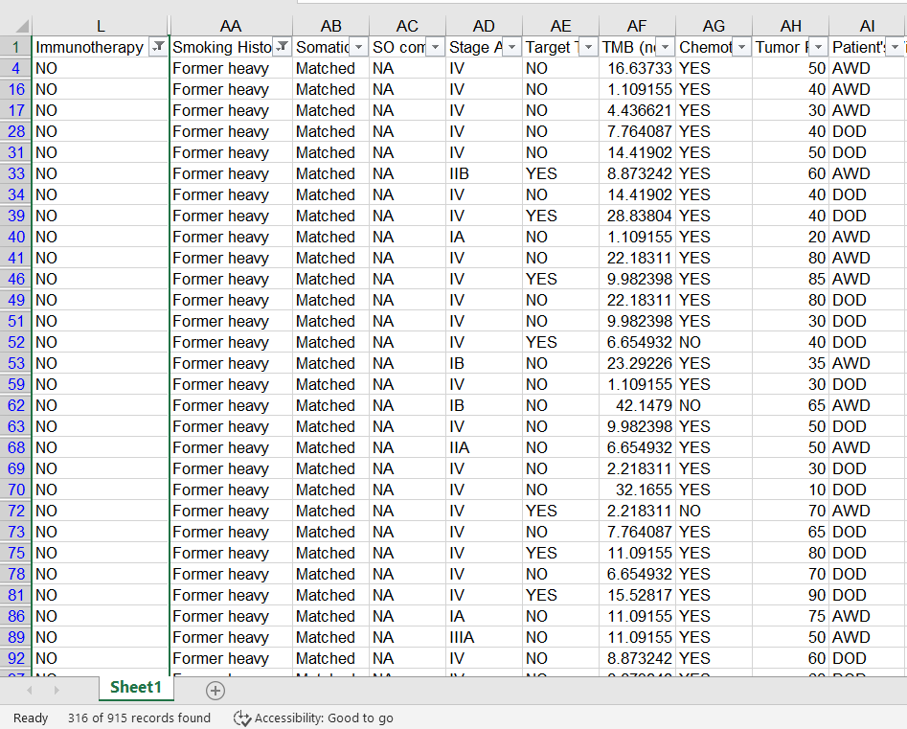
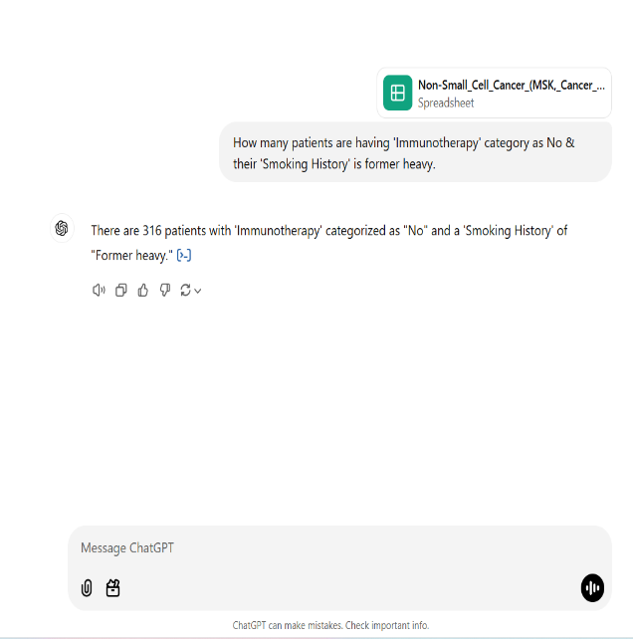
RESULTS AND DISCUSSION
Qualitative Evaluation for Structured Approach:

Slide 20
CONCLUSION
Contributed to Significant advancements in Generative AI for Document Question Answering Intelligence in healthcare, particularly cancer data.
Demonstrated improvements over traditional NLP techniques with high contextual understanding and efficiency.
Models effectively handling complex queries, providing concise, accurate, and relevant answers.

Slide 21
FUTURE RECOMMENDATIONS:
Exploring the integration of structured databases with LLMs using Pandas AI for enhanced accuracy.
Incorporating OCR and advanced data processing for unstructured and structured models to expand data handling capabilities for diverse data.
Improving the Retrieval-Augmented Generation and Table Augmented Generation techniques which can understand the meaningful content from tables, flowcharts, Agents framework etc.
Continue leveraging Generative AI advancements such as agents to enhance system accuracy, reliability, and applicability.

Slide 22


